Slide 1


Mohammad Yousefi ghaleh joogh
9/22/2023

Slide 2

Outline
Executive Summary
Introduction
Methodology
Insight drawn from EDA
Launch Sites Proximities Alnalysis
Dash Board
Predictive Analysis
Conclusion

Slide 3
Executive Summary
Summary of methodologies
1. Collecting Data by using API and Web Scraping
2. Performing Data Wrangling and EDA
3. Create Interactive charts and maps
4. Performing ML models for predicting outcomes
Summary of all results
1. Performing EDA analysis
2. Performing interactive analysis
3. Performing Predictive Analytics

Slide 4
Introduction
SpaceX's Falcon 9 is a two-stage partially reusable rocket which is capable to carry cargo and crew into Earth orbit and beyond
The reusability of first stage of the rocket helped SpaceX to outperformed his rivals and it is important to predict successful landing of the rocket, Since it has direct impact on the final cost of the shipment and its competitiveness price which is 62 Million Dolor.
What is our aim in this project?
We will explore most factors that affect Falcon9 landing and find most important ones and relation between those factors, then by using different Machine Learning models we try to predict probability of successful/failed landing of the rocket.

Slide 5

Section 1

Slide 6
Methodology
Executive Summary
Data collection methodology:
Gathering data by using SpaceX official API
Gathering data from web by web scraping (Wikipedia)
Perform data wrangling
Converting raw data into a usable form for analysis including cleaning, organizing, and transforming
Perform exploratory data analysis (EDA) using visualization and SQL
Perform interactive visual analytics using Folium and Plotly Dash
Perform predictive analysis using classification models
Converting raw data into a usable form for analysis including cleaning, organizing, and transforming

Slide 7
Data Collection
The First Step Is Gathering Data Needed For Analysis. This Is Down By Two Methods:
The Spacex Company Officially Publish The Data And We Can Get Datas In Form Of Json Files Which Can Later Converted To Dataframe To Be Use In Python (https://api.spacexdata.com/v4/)
In Second Method Data Can Be Access By Web Scraping From Wikipedia (https://en.wikipedia.org/wiki/List_of_Falcon_9_and_Falcon_Heavy_launches)
With Data In Hand:
Read Data Into A DataFrame
Save as CSV Fill
Select Features
Cleaning Data
Dealing With Null Values

Slide 8
Data Collection – SpaceX API
Send Request by SpaceX API
Get Result in Json
Convert Json To DataFrame
Get Complementary Data By API
Filter Falcon9
Check Missing Values
Dealing With Null Values
Save Data to CSV format
https://github.com/mygir77/IBM-Applied_Data_Science_Capstone/blob/main/p1_data_collection.ipynb

Slide 9
Data Collection - Scraping
Request SpaceX Wiki Page
Extract Data by BeautifulSoup
Convert Data To DataFrame
Save Data to CSV format
https://github.com/mygir77/IBM-Applied_Data_Science_Capstone/blob/main/p2_jupyter-labs-webscraping.ipynb

Slide 10
Data Wrangling
Get Number Of Launch for each Launch Site
Get Number of Occurrence of Each Orbit
Get Occurrence Of Mission Outcome
Create and Label Outcome Column
Save Dataset in A CSV file
In this section we performed Exploratory Data Analysis and Determine Training Labels
https://github.com/mygir77/IBM-Applied_Data_Science_Capstone/blob/main/labs-jupyter-spacex-Data%20wrangling.ipynb

Slide 11
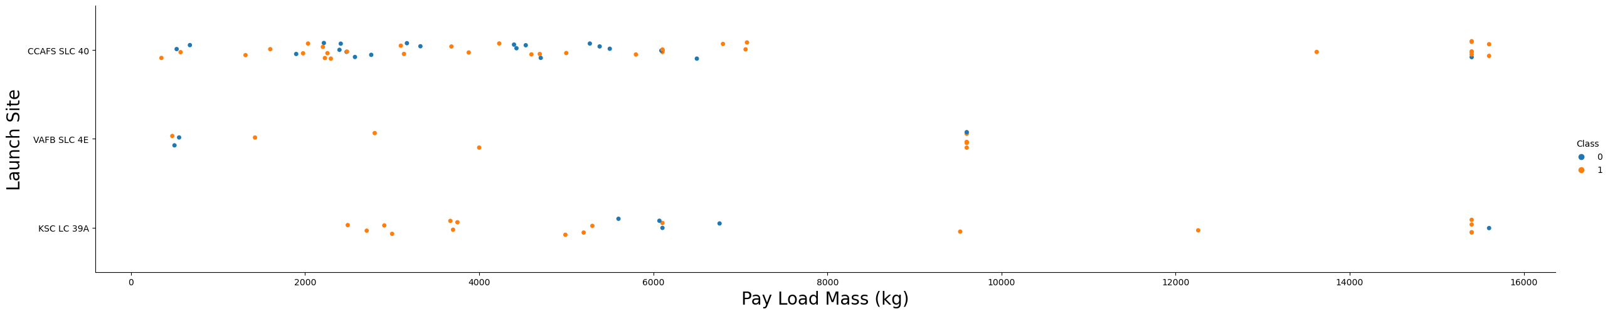
EDA with Data Visualization
The Main Objective In This Section Is To Perform EDA And Data Feature Engineering.
EDA Is Visual Representation Of Our Data Which Help Us To Explore Relationships Between Different Features And Make It Easier For Us To Understanding Them. For Example help us to understand relationship between Launch Site and Orbit. Or relationship between Payload and Launch Site
https://github.com/mygir77/IBM-Applied_Data_Science_Capstone/blob/main/jupyter-labs-eda-dataviz_final.ipynb

Slide 12
EDA with SQL
In This Part We Use SQL To Retrieve Data Then We Accomplish Following Tasks:
Display the names of the unique launch sites in the space mission
Display the total payload mass carried by boosters launched by NASA (CRS)
Display average payload mass carried by booster version F9 v1.1
List the date when the first successful landing outcome in ground pad was achieved.
List the names of the boosters which have success in drone ship and have payload mass greater than 4000 but less than 6000
List the total number of successful and failure mission outcomes
names of the booster_versions which have carried the maximum payload mass
https://github.com/mygir77/IBM-Applied_Data_Science_Capstone/blob/main/jupyter-labs-eda-sql-coursera_sqllite.ipynb

Slide 13
Build an Interactive Map with Folium
Folium is a powerful Python library that helps you create several types of Leaflet maps. In this part By Folium API, in generated maps:
Mark all launch sites on a map
Mark the success/failed launches for each site on the map
Calculate the distances between a launch site to its proximities
Circles: represents Launch Sites
Colored Markers: Success/Failures in each launch Site
Lines: to show distances to nearest City, railway, coastline and highway
https://github.com/mygir77/IBM-Applied_Data_Science_Capstone/blob/main/lab_jupyter_launch_site_location_final.ipynb

Slide 14
Build a Dashboard with Plotly Dash
In this section we utilize the power of Plotly and Dash library to create a web app to interactively visualizing the data. This enable us to study relationship between Launch sites, Payload mass and booster types easily.
Create dropdown list to enable Launch Site selection
Create a pie chart to show the total successful launches count for all sites
Create a slider to select payload range
Create a scatter chart to show the correlation between payload and launch success
https://github.com/mygir77/IBM-Applied_Data_Science_Capstone/blob/main/spacex_dash_app_final.py

Slide 15
Predictive Analysis (Classification)
In This Part We Use Scikit-learn Python Library For Performing Machine Learning For Prediction Falcon 9 Rocket Success/Failure Base On Some Selected Features. Then We Try To Find Best Hyper-paramters For One Of The Models And Determine Which One Of The Machine Learning Models Predict With Higher Accuracy.
Read Dataset
Create X&Y
Standardize data
Split Test & Train data
Create GridSearchCV object
Train ML Model
Calculate Accuracy of Model
Choose best ML model
https://github.com/mygir77/IBM-Applied_Data_Science_Capstone/blob/main/SpaceX_Machine%20Learning%20Prediction_Part_5.ipynb

Slide 16
Results
Exploratory data analysis demonstrate by increasing Flight Number from 2013 to 2020 success rate increased some launch site have Higher success ratio
Interactive analytics web app, shows 2000-6000 kg with FT booster have performed better
In Predictive analysis section, we come up with Decision tree has better performance with 83% accuracy.

Slide 17

Section 2

Slide 18
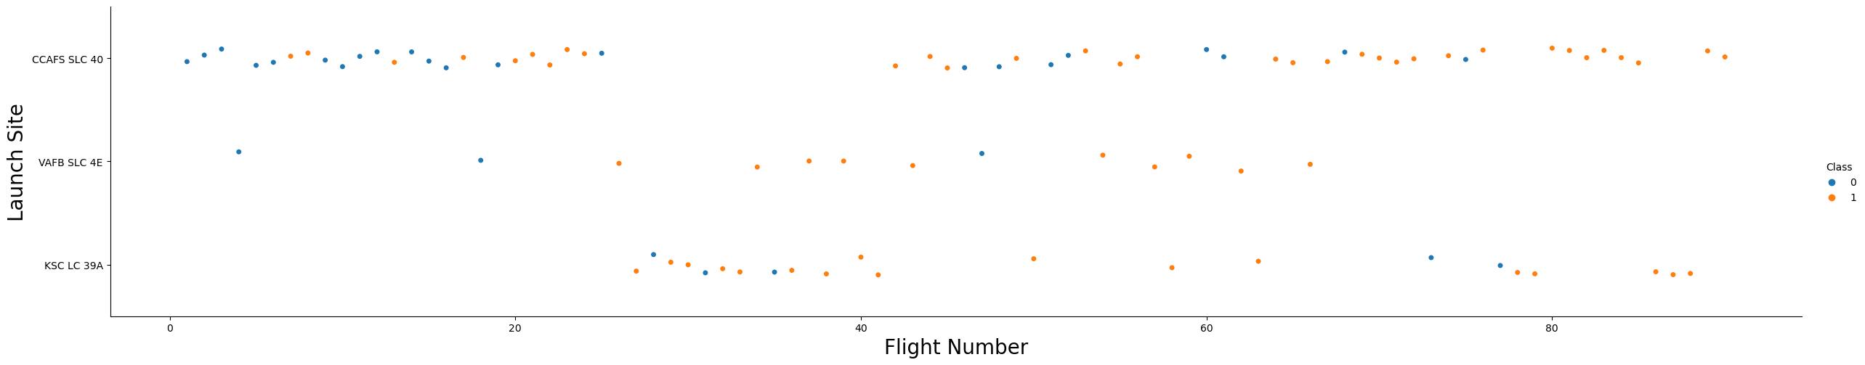
Show a scatter plot of Flight Number vs. Launch Site
Show the screenshot of the scatter plot with explanations
Flight Number vs. Launch Site
Scatter plot of Flight Number vs. Launch Site
As the project go further, Obviously FlightNumber 80, Successful landing increased.
Most used site is CCSFS SLC 40 (Cape Canaveral Space Launch Complex)

Slide 19
Payload vs. Launch Site
Scatter plot of Payload vs. Launch Site
Base on this Plot VAFB SLC 4E did not used for PayLoad more then 10000Kg

Slide 20
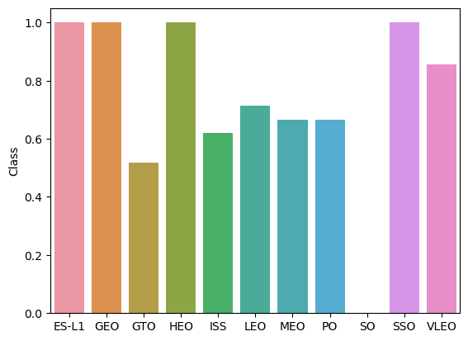
Success Rate vs. Orbit Type
Bar chart for the success rate of each orbit type
This Bar chart propose ES-L1, GEO, HEO, SSO orbits have more success rate
Going to GTO orbit has the lowest success rate

Slide 21
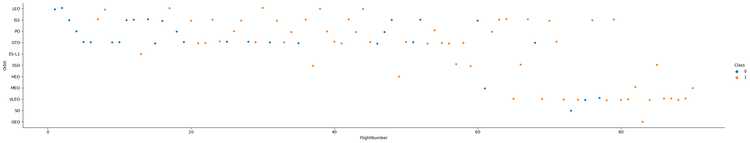
Flight Number vs. Orbit Type
Previous Bar cart shows High success rate for GEO, SSO and HEO, but this plot indicates these 3 orbits have the lowest Flight attempts and their success cannot be that much accountable.
In recent Flight numbers VLEO orbit has most success landing

Slide 22
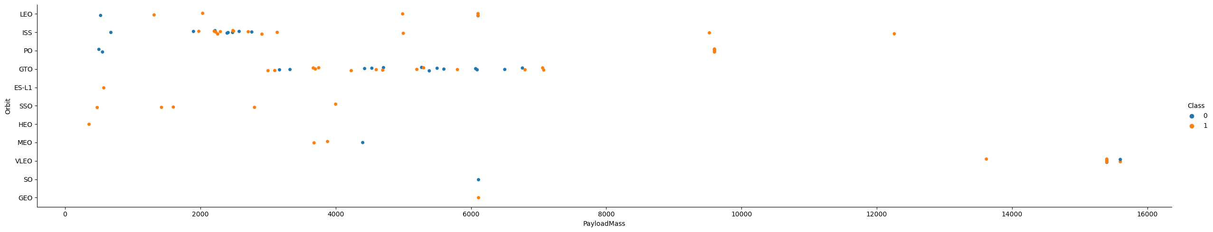
Payload vs. Orbit Type
PO, LEO, LEO have the most success rate on Heavy Loads
VLEO not used for light Payloads

Slide 23
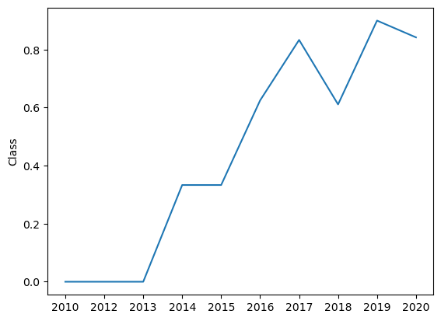
Launch Success Yearly Trend
After 2013 success rate keep increasing

Slide 24
All Launch Site Names
%sql SELECT DISTINCT Launch_Site from SPACEXTABLE;
Launch_Site
CCAFS LC-40
VAFB SLC-4E
KSC LC-39A
CCAFS SLC-40

Slide 25
Launch Site Names Begin with 'CCA'
%sql SELECT * from SPACEXTABLE where LAUNCH_SITE LIKE 'CCA%' LIMIT 5;
Date | Time (UTC) | Booster_Version | Launch_Site | Payload | PAYLOAD_MASS__KG_ | Orbit | Customer | Mission_Outcome | Landing_Outcome
2010-04-06 | 18:45:00 | F9 v1.0 B0003 | CCAFS LC-40 | Dragon Spacecraft Qualification Unit | 0 | LEO | SpaceX | Success | Failure (parachute)
2010-08-12 | 15:43:00 | F9 v1.0 B0004 | CCAFS LC-40 | Dragon demo flight C1, two CubeSats, barrel of Brouere cheese | 0 | LEO (ISS) | NASA (COTS) NRO | Success | Failure (parachute)
2012-05-22 | 07:44:00 | F9 v1.0 B0005 | CCAFS LC-40 | Dragon demo flight C2 | 525 | LEO (ISS) | NASA (COTS) | Success | No attempt
2012-08-10 | 00:35:00 | F9 v1.0 B0006 | CCAFS LC-40 | SpaceX CRS-1 | 500 | LEO (ISS) | NASA (CRS) | Success | No attempt
2013-01-03 | 15:10:00 | F9 v1.0 B0007 | CCAFS LC-40 | SpaceX CRS-2 | 677 | LEO (ISS) | NASA (CRS) | Success | No attempt

Slide 26
Total Payload Mass
%sql SELECT SUM(PAYLOAD_MASS__KG_) from SPACEXTABLE where (Customer) LIKE 'NASA (CRS)';
SUM(PAYLOAD_MASS__KG_)
45596

Slide 27
Average Payload Mass by F9 v1.1
Calculate the average payload mass carried by booster version F9 v1.1
%sql SELECT avg(PAYLOAD_MASS__KG_) from SPACEXTABLE where Booster_Version = 'F9 v1.1';
Avg(PAYLOAD_MASS__KG_)
2928.4

Slide 28
First Successful Ground Landing Date
Find the dates of the first successful landing outcome on ground pad
%sql SELECT min(Date) from SPACEXTABLE where Landing_Outcome = 'Success (ground pad)' ;
Min(Date)
2015-12-22

Slide 29
Successful Drone Ship Landing with Payload between 4000 and 6000
List the names of boosters which have successfully landed on drone ship and had payload mass greater than 4000 but less than 6000
%sql SELECT Booster_Version from SPACEXTABLE where (Landing_Outcome = 'Success (drone ship)') and (PAYLOAD_MASS__KG_ BETWEEN 4000 and 5999)
Booster_Version
F9 FT B1022
F9 FT B1026
F9 FT B1021.2
F9 FT B1031.2

Slide 30
Total Number of Successful and Failure Mission Outcomes
Calculate the total number of successful and failure mission outcomes
%sql SELECT Mission_Outcome, COUNT(Mission_Outcome) as MissionResult from SPACEXTABLE GROUP BY Mission_Outcome;
Mission_Outcome | MissionResult
Failure (in flight) | 1
Success | 99
Success (payload status unclear) | 1

Slide 31
Boosters Carried Maximum Payload
List the names of the booster which have carried the maximum payload mass
Booster_Version
F9 B5 B1048.4
F9 B5 B1049.4
F9 B5 B1051.3
F9 B5 B1056.4
F9 B5 B1048.5
F9 B5 B1051.4
F9 B5 B1049.5
F9 B5 B1060.2
F9 B5 B1058.3
F9 B5 B1051.6
F9 B5 B1060.3
F9 B5 B1049.7
%sql SELECT BOOSTER_VERSION from SPACEXTABLE WHERE PAYLOAD_MASS__KG_=(select max(PAYLOAD_MASS__KG_) from SPACEXTABLE);

Slide 32
2015 Launch Records
List the failed landing_outcomes in drone ship, their booster versions, and launch site names for in year 2015
%sql SELECT SUBSTR(Date,6,2) as Month,Date, Booster_Version,Launch_Site from SPACEXTABLE WHERE SUBSTR(Date,1,4)='2015' and Landing_Outcome ='Failure (drone ship)';
Month | Date | Booster_Version | Launch_Site
10 | 2015-10-01 | F9 v1.1 B1012 | CCAFS LC-40
04 | 2015-04-14 | F9 v1.1 B1015 | CCAFS LC-40

Slide 33
Rank Landing Outcomes Between 2010-06-04 and 2017-03-20
Rank the count of landing outcomes (such as Failure (drone ship) or Success (ground pad)) between the date 2010-06-04 and 2017-03-20, in descending order
%sql SELECT Landing_Outcome, COUNT(*) as count_outcomes from SPACEXTABLE where Date between '2010-06-04' and '2017-03-20' group by [Landing_Outcome] order by count_outcomes DESC;
Landing_Outcome | count_outcomes
No attempt | 10
Success (ground pad) | 5
Success (drone ship) | 5
Failure (drone ship) | 5
Controlled (ocean) | 3
Uncontrolled (ocean) | 2
Precluded (drone ship) | 1
Failure (parachute) | 1

Slide 34

Section 3

Slide 35
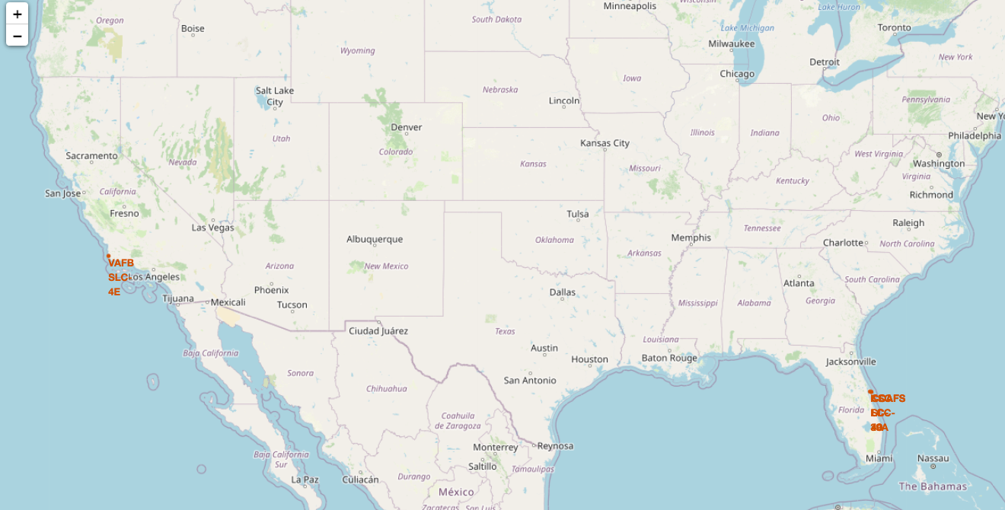
launch sites locations on a map
All Launch Site Sited near the coast lines

Slide 36
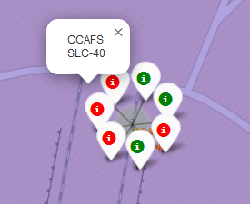
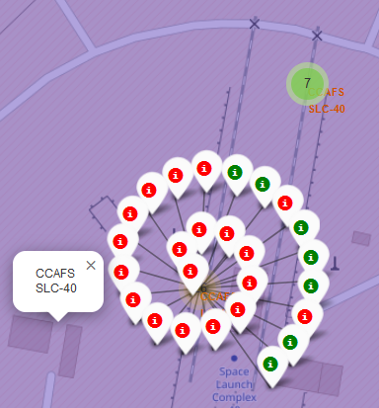
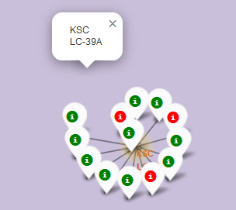
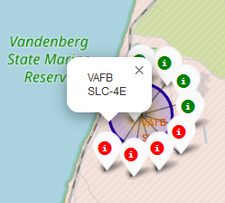
Launch Site Success Rates
KSC LC-39A has most success for falcon 9 landing
CCAFS SLC-40 has most failed mission

Slide 37
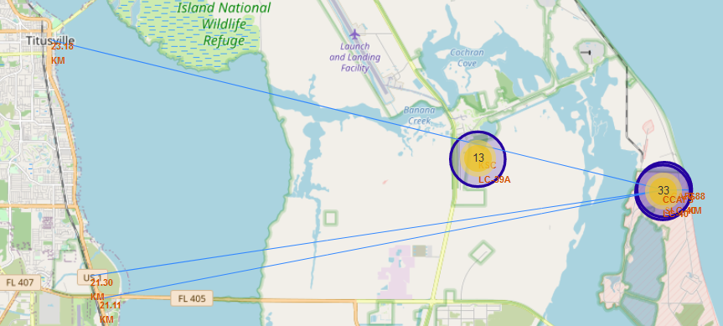
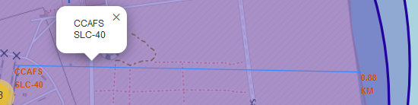
Distances between a launch site to its proximities
AS you can see distance to Nearest :
City: 23 Km
Railway: 21 km
Highway: 21km
Coastline: 0.9 km

Slide 38

Section 4

Slide 39
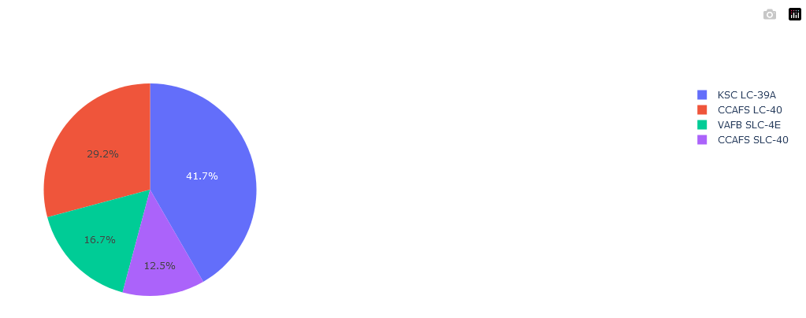
Total successful launches count for all sites
KSC LC-39A has highest Success among the other launch sites and CCAFS –LC-40 comes next.

Slide 40
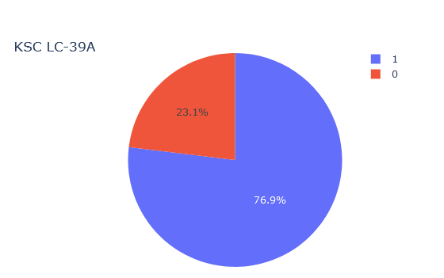
Success/Fail of most successful launch site
KSC LC-39A as most successful launch site has 76.9% success and 23.1% failure.

Slide 41
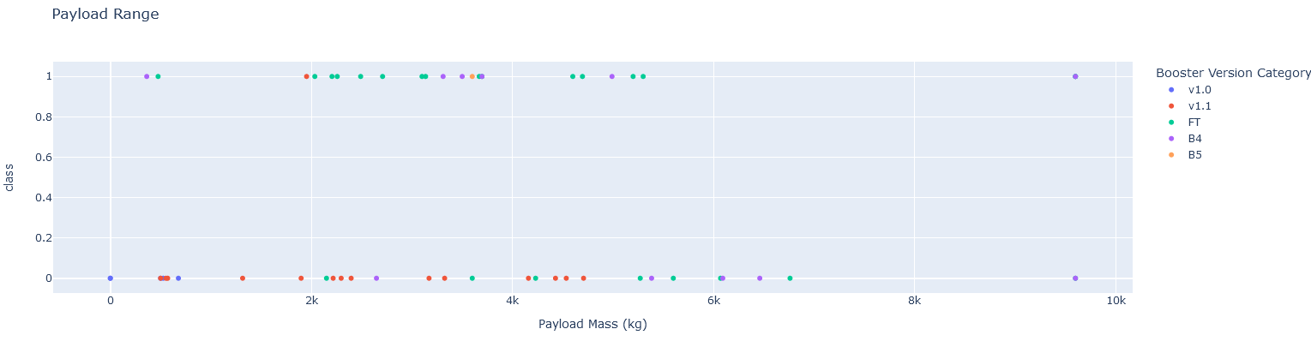
Scatter for Payload vs Launch Outcome for all sites
Payloads between 2000-6000 kg have more chances to land successfully
FT Booster has higher success rate

Slide 42

Section 5

Slide 43
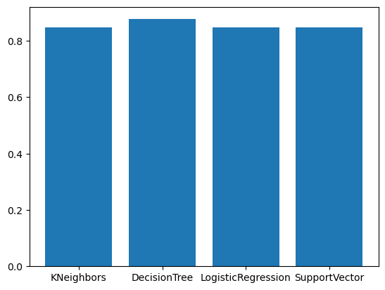
Classification Accuracy
This chart indicates accuracy of models doesn't different with each other dramatically. But in overall, Decision Tree has higher accuracy.

Slide 44
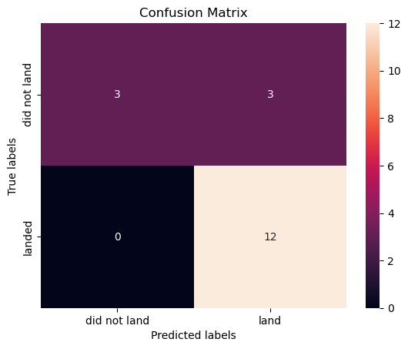
Confusion Matrix
Confusion matrix of Decision Tree model indicates this model has some difficulties in predict Failed Landing that predict as Landed mission(FN, Type2 error)

Slide 45
Conclusions
By increasing Flight Number, Successful landings are increased
By pass time from 2013 to 2020, successful Landing increased
KSC LC-39A launch Site is best place for Landing
In recent Launches, VLEO orbit outperformed the other ones
PayLoad with 2000-6000 kg have higher success rate with FT booster
For prediction Purpose, Decision Tree model perform slightly better

Slide 46


